Slide 1
Gadgets4You Transaction Data
Shruti - Clement
Saran -Anokhi

Slide 2
INTRODUCTION
In this presentation, we will show how our agency has been instrumental in assisting Gadget4You to effectively analyze the transaction data.
We were able to extract valuable insights and provide deeper understanding of the business operations.

Slide 3
First day
Last day
TIME RANGE OF THE DATA SET
01/12/2018
09/12/2019

Slide 4
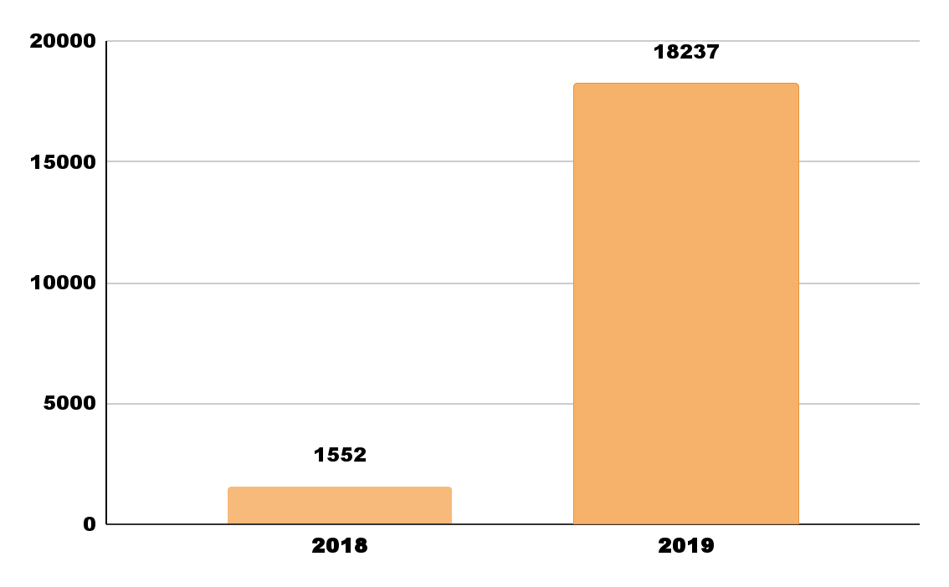
UNIQUE TRANSACTIONS IN 2018-2019
2018
1552
2019
18237
Growth = 1073.09%

Slide 5

BEST SELLING PRODUCT
Paper Craft Little Birdie
Sales Frequency: 80995

Slide 6
PRODUCTS SOLD ONLY ONCE &
HAVE ‘BLUE’ IN THEIR NAME
Yellow/Blue Retro Radio
Ubo-Light Triobase Blue
Antique Mid Blue Flower Earrings
Acrylic Jewel Icicle Blue
Small Blue Provencal Ceramic Ball
Blue Bunny Easter Egg Basket
Blue Crusoe Check Lampshade
Blue Padded Soft Mobile
Blue Drop Earrings W Bead Cluster
Blue/Nat Shell Necklace W Pendant
Blue Crystal Boot Phone Charm
Blue New Baroque Flock Candlestick
Blue Organdy Round Lampshade W Bea
Green/Blue Flower Design Big Mug
Set 4 Picnic Cutlery Blueberry
Silicon Cube 25w Blue

Slide 7
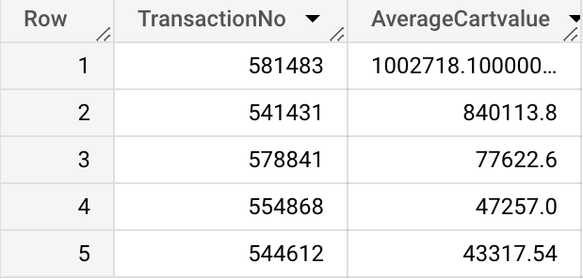
AVERAGE CART VALUE
Average number of unique products per transaction
26.11

Slide 8

COUNTRIES WITH THE HIGHEST AVERAGE CART VALUE AND THE LOWEST
Sweden = 984.99
Iceland=48.69

Slide 9
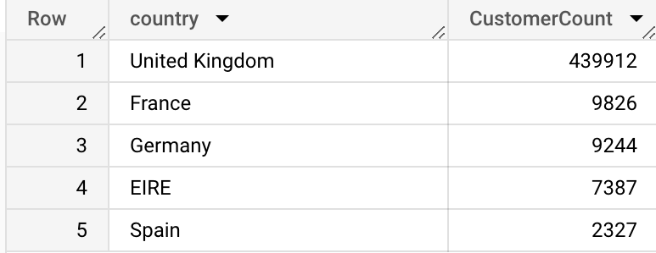
CUSTOMERS FROM COUNTRIES WITH THE MOST ORDERS PLACED IN 2019

Slide 10
Questions? Thank You!

